Slide 1
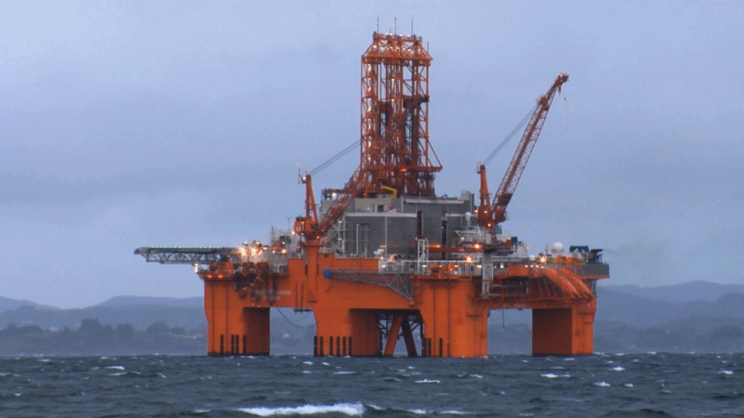
Offshore Oil Production
Problem type: Classification

Slide 2

Problem Statement
Daily Oil Production Volume is required to calculate profitability and assess reservoir condition
Oil production is volatile due to mix of Water and Gas during extraction.
Expensive Well Test ($200k) or Multiphase fluid measuring meter ($250k to $400k) is required for continuous Oil production measurement
Requires many multiphase flow meter that costs ranges from $250k to $1m for each, can lead to $20m to $25m Capital expenditure only for sensor just for 1 platform
Operators seeking
A virtual meter that provides produced oil volume
Replace the costly sensors with virtual sensor that can save them $5m to $7m for multiple oil well in deep ocean

Slide 3

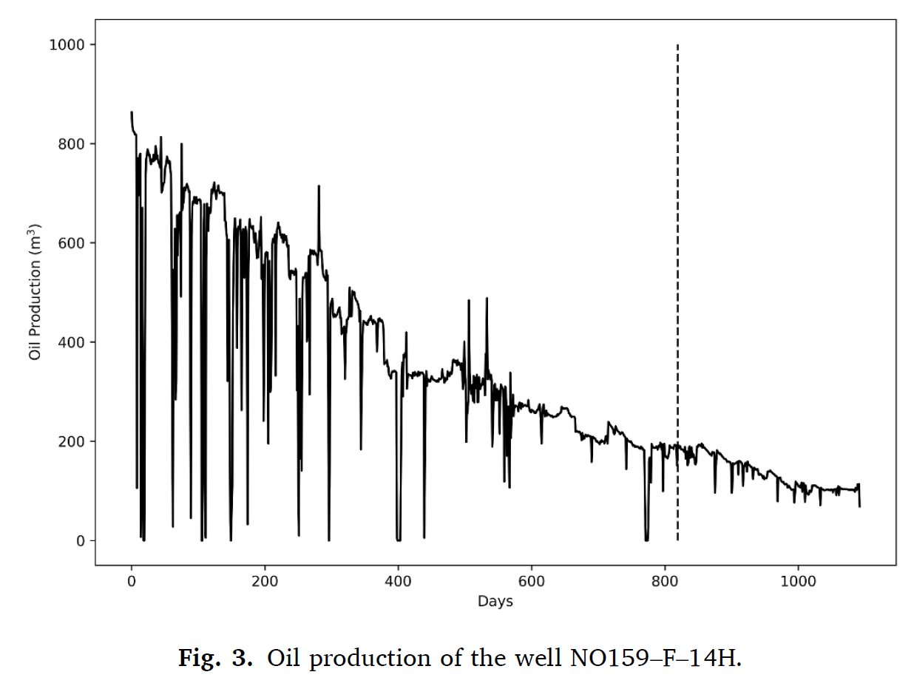
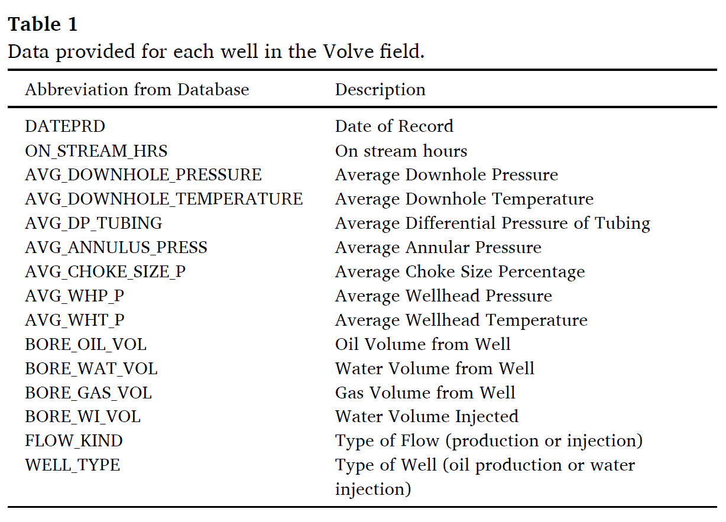
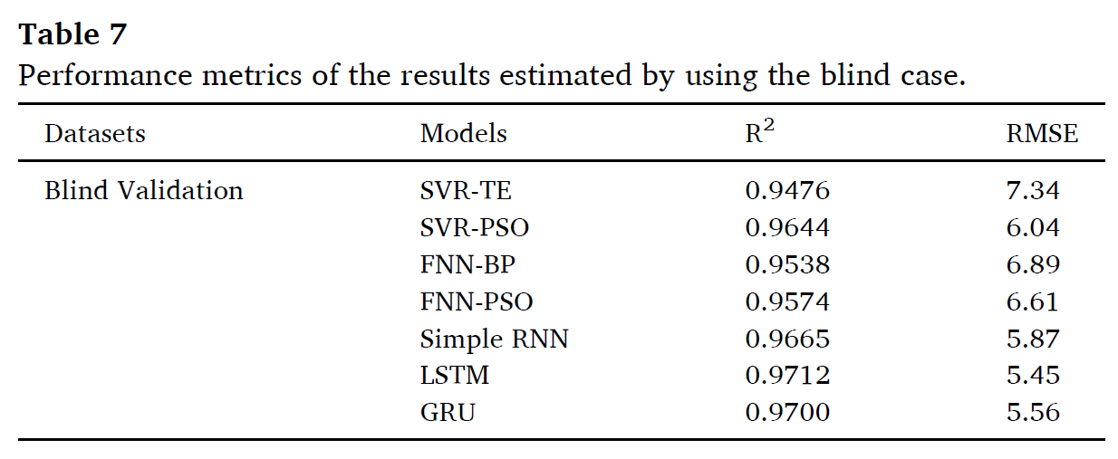
Publication Level Work

Slide 4
Oil Production Data for Volve Field
Norway
The Training Data Obtained from online sources defined in the publication

Slide 5

So lets Run with a Robot AI…..

Slide 6
Diagnose the component failure with 4 steps
Under Energy Project
Create Solution Name “Offshore Oil Production”→ Regression → Click create solution
Data
Build Model
Name your data “Oil Production” → upload Offshore_Oil_Production_Train.csv
Select target. Choose “BORE_OIL_VOL” as your target
A window will pop up asking you run the preliminary analysis or not. Press Yes Button
Preliminary analysis will run-→see result in Confusion Matrix and Prediction KPI for error
Press Next→ land in “build Model page
Select Variables for feature engineering
Select Unselect Variable
Select Algorithm
Linear Regression
Random Forest
XGBoost
Click on Train
Click on Finalize
You will land on Deploy page

Slide 7
Diagnose the component failure with 4 steps
Deploy
Decision
Click on Add data→
upload new data from CSV source from you computer Offshore_Oil_Production_Pred.csv file
Create Equation for decision making
Go to Result Configuration
Check download as CSV
Select Algorithm
Random forest or other
Press “Predict”, prediction will running
Press Next→ you will land in Decision Page
Select Decision Scenario Tab
Change slider value for different variables
Press Apply
Do the step until Target or Target desired value is higher or lower or middle

Slide 8


